Slide 1
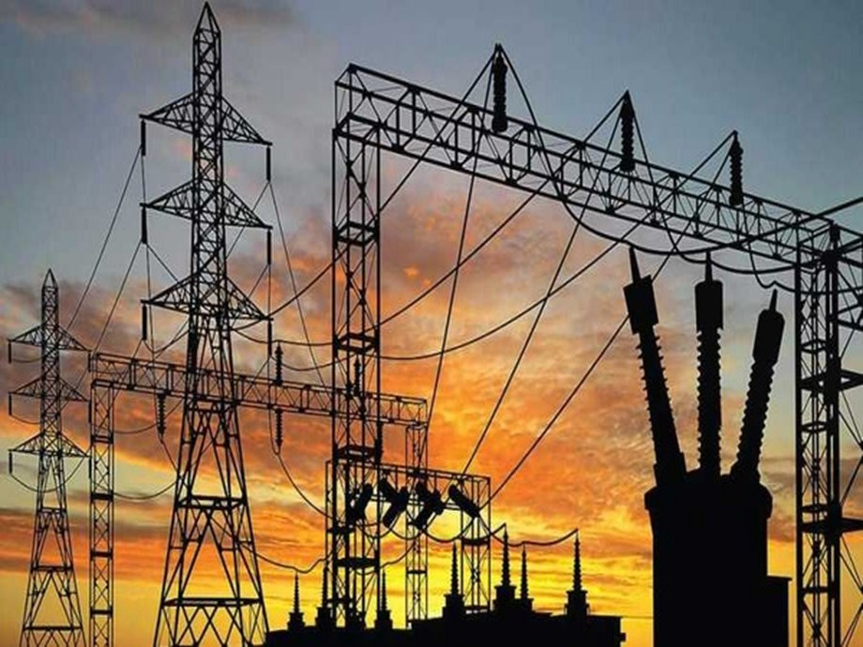
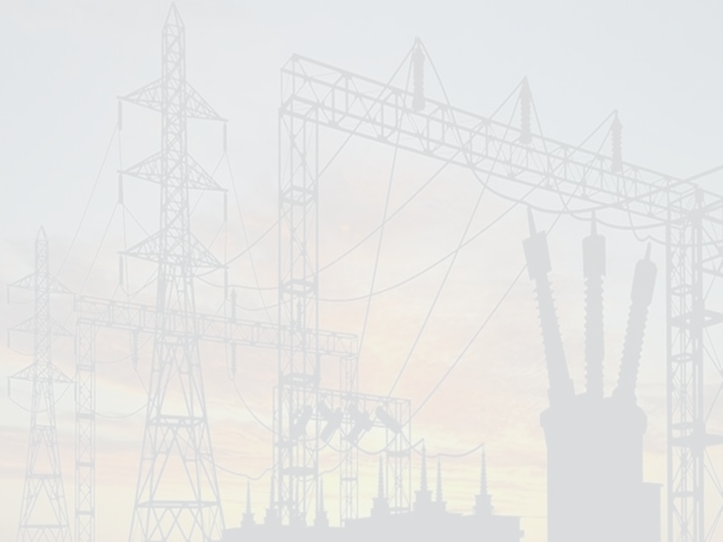


ELECTRICITY
BILLING
SYSTEM

Slide 2



INTRODUCTION
Electricity Billing System is a Desktop-based application.
•This project aims at serving the department of electricity by computerizing the billing system.
•It mainly focuses on the calculation of units consumed during the specified time and the money to be charged by the electricity offices.
•This computerized system will make the overall billing system easy, accessible, comfortable, and effective for consumers.
The main aim of our project is to satisfy customer by saving their time by payment process, maintaining records, and allowing the customer to view his/her records and permitting them to update their details

Slide 3

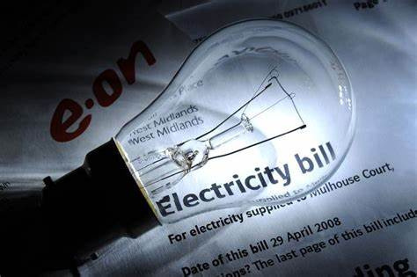
OBJECTIVE OF THE PROJECT
•To keep the information of consuming unit energy of current month.
•To keep the information of Customer.
•To keep the information of consuming unit energy of previous month.
•To calculate the units consumed every month regularly.
•To generate the bills adding penalty and rent.
•To save the time by implementing payment process online.

Slide 4
REQUIREMENTS OF PROJECT
Window 10/XP
Registration with System
Authorized Website
User name and Password

Slide 5
FEATUERS OF PROJECTS
01
EBMS is windows based Electricity Billing management software. Provides password facility for different users to ensure a high level of security.
02
It is completely user-friendly Electricity Billing management software.
03
It is Avoid Data manipulations.

Slide 6
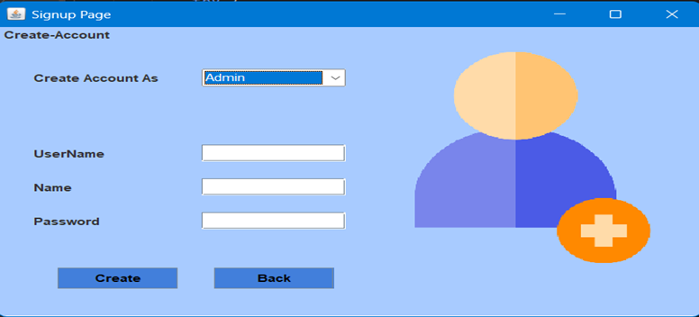
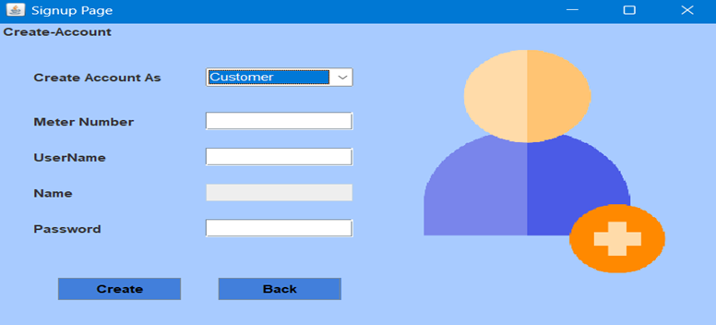
A
D
M
I
N
SIGN UP
C
U
S
T
O
M
E
R
Customers User have to enter meter-no, username, name, password.
Here New customers/Admin will signup to access their accounts.
Admin User have to enter username, name, password

Slide 7
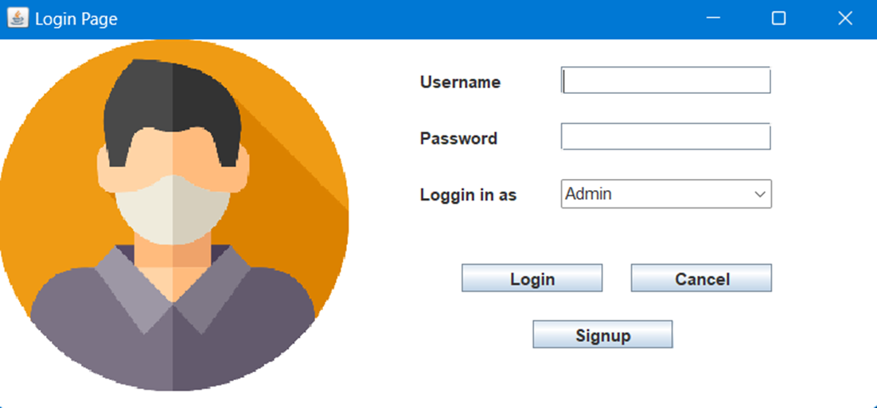
LOGIN
L
O
G
I
N
The dropdown menu allows to choose whether to login as an admin or as a customer.
Here Customer and Admin can login to their respective accounts.

Slide 8
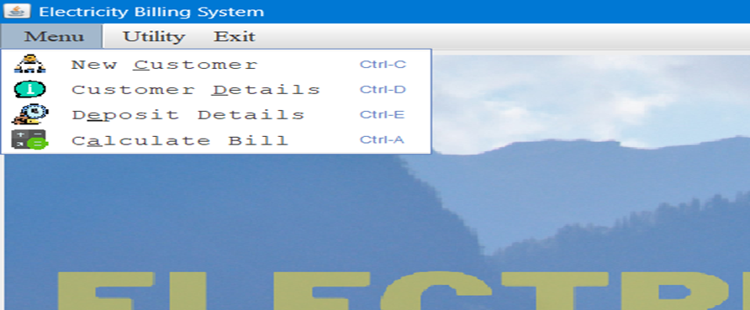
Admin’s Home Screen:
SIGN UP
This Screen Contains various fields like in menu section New Customer, Customer Details, Deposit Details, Calculate Bill.
Admin lands on this page after successful login.
In Utility section we have Notepad, Calculator.
Exit is for Logout.

Slide 9
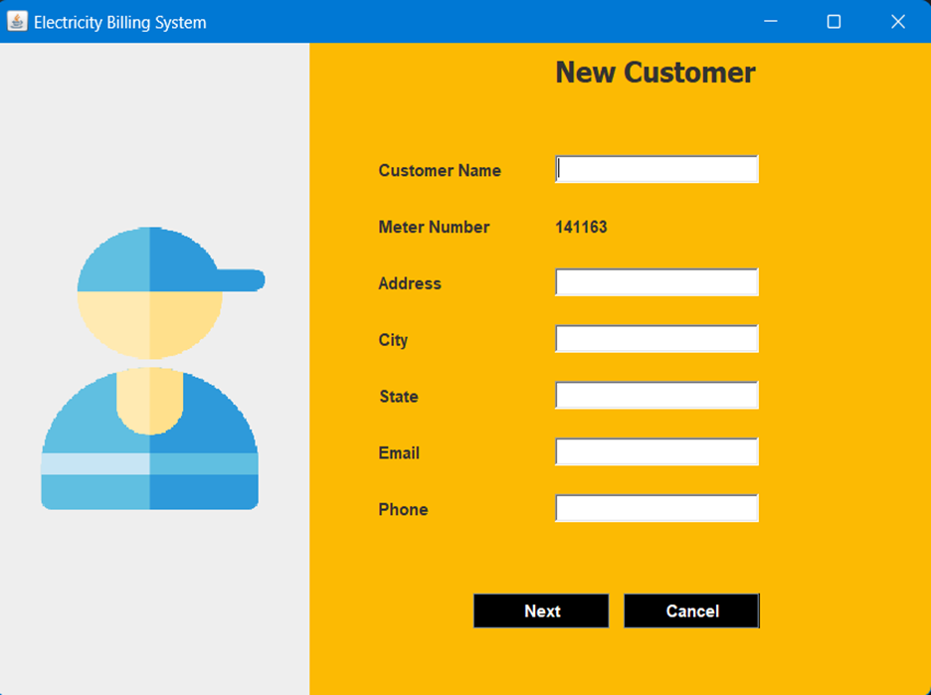
NEW
CUSTOMER
If customer name, address, city, state, email and phone number is entered, insert the values into customer else print error.
This program will allow the admin to enter the customer details and automatically generates unique meter number.

Slide 10
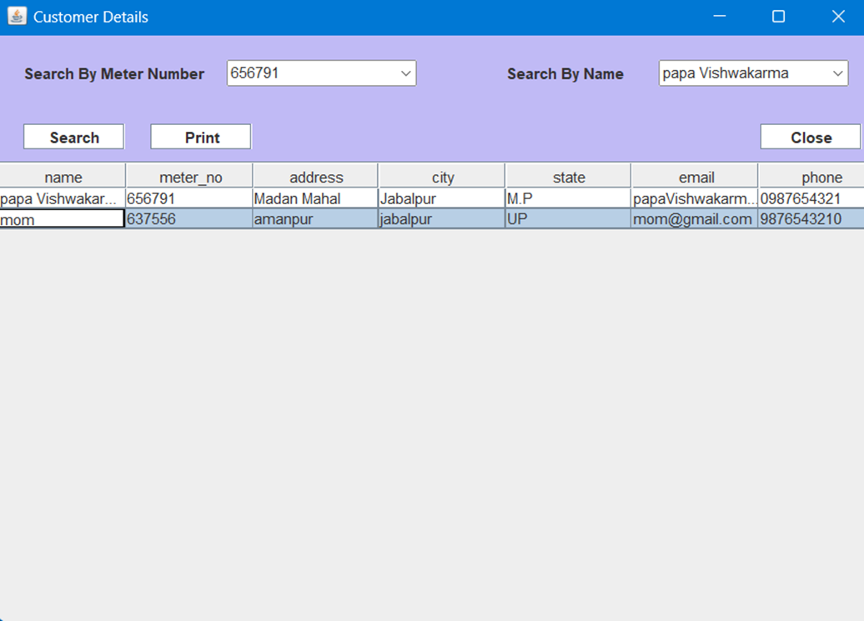
CUSTOMER
DETAILS
If we need to print the details that has been viewed click onto print option.
This program will allow the admin to view customer details.

Slide 11
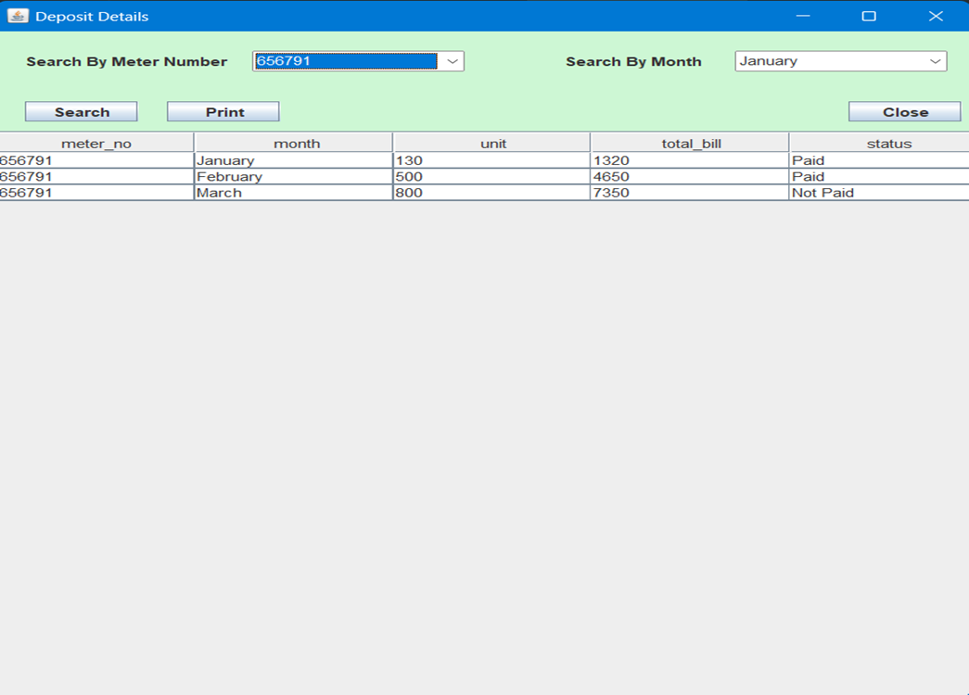
DEPOSIT
DETAILS
If we need to search the particulars that has been viewed click onto search option.
This program will allow the admin to view bill details. If we need to sort the details based on meter_no and month.
If we need to print the particulars that has been viewed click onto print option.

Slide 12
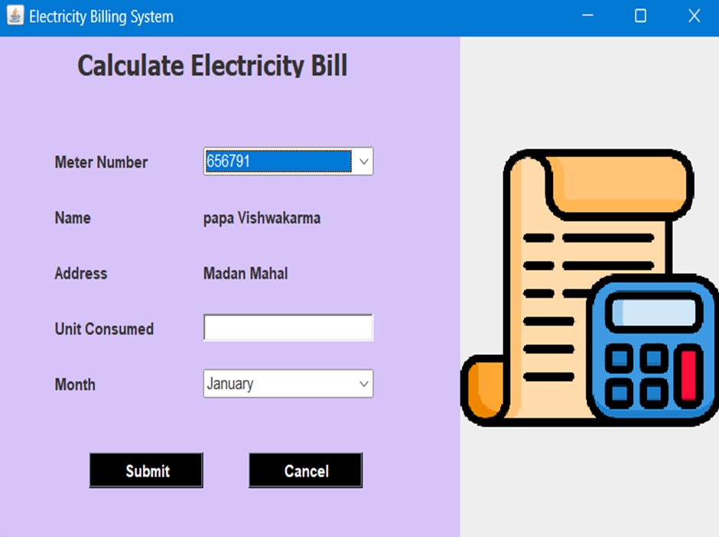
CALCULATE
BILL
Submit the details of tax that has been entered by clicking onto submit button.
This program will allow the admin to calculate total bill when units consumed are inserted where meter-no and month is selected.
If we need to cancel the details that has been entered click onto cancel option.

Slide 13
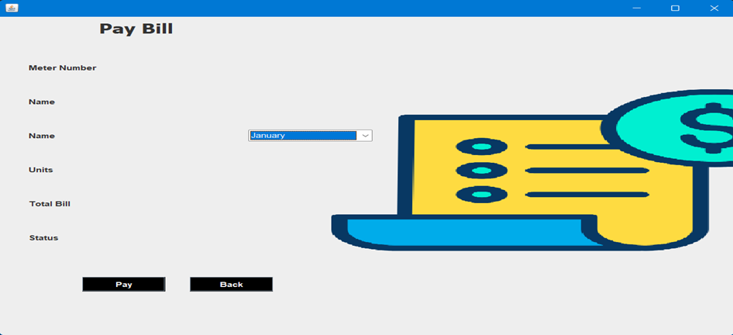
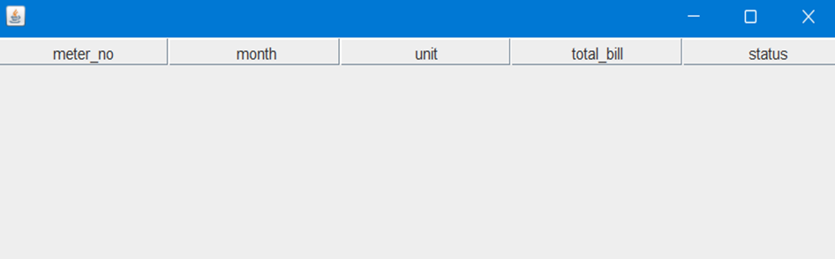
PAY
BILL
Here customers pay their bills by selecting appropriate month.
BILL
DETAILS
Here every customer can check the status of their bills, whether they have paid the bills or not.

Slide 14
CONCLUSION
It is a software which helps the user to work with the billing cycles,
paying bills, managing different DETAILS under which are working etc.
This software reduces the amount of manual data entry and gives greater efficiency. The User Interface of it is very friendly and can be easily used by anyone.
It also decreases the amount of time taken to write details and other modules.

Slide 15
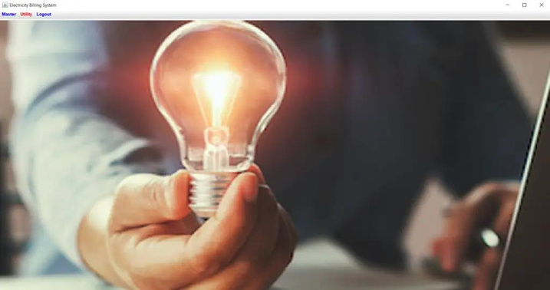

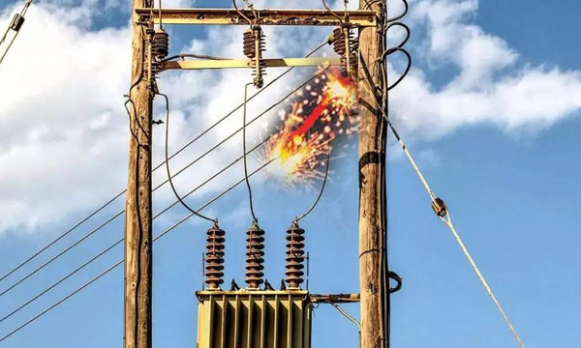

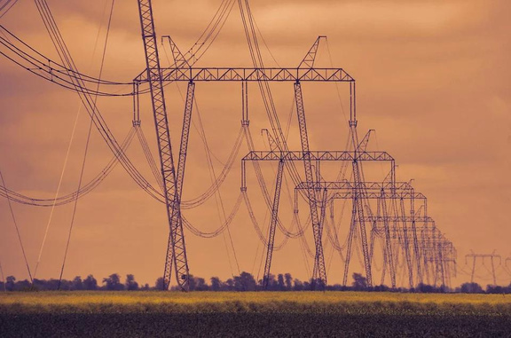

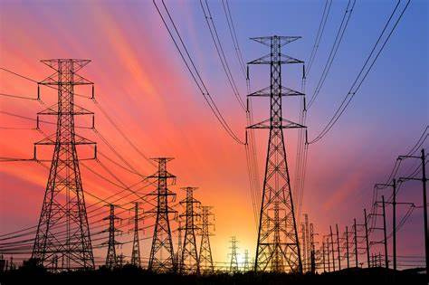
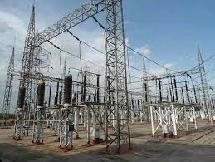

THANK'S FOR WATCHING

